Slide 1
ARM9 Interrupt latency measurement and Data storage for Analysis
Team Project
Christian Wörz 747833
Sanjeev Kumarr Gopal 747763
27.06.2014
[1]

Slide 2
Task description
On chip interrupt latency measurement
Provide timestamp and metered result
Compensation / correction of the result
Transmit the values to a computer
Store values in a database
Implement queries, (WCET, time range)

Slide 3
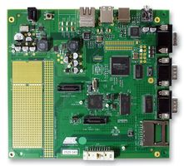
The Chip
ATMEL AT91RM9200:
ARM9 32Bit controller
>1MIPS per MHz
RTC, PMC, USB, Ethernet, ..
16 Register + CPSR
[1]
Advanced Interrupt Controller (AIC):
8 priority interrupt level (nested interrupts)
Fast interrupt, including banked registers
Flexible configuration and interrupt vectoring

Slide 4
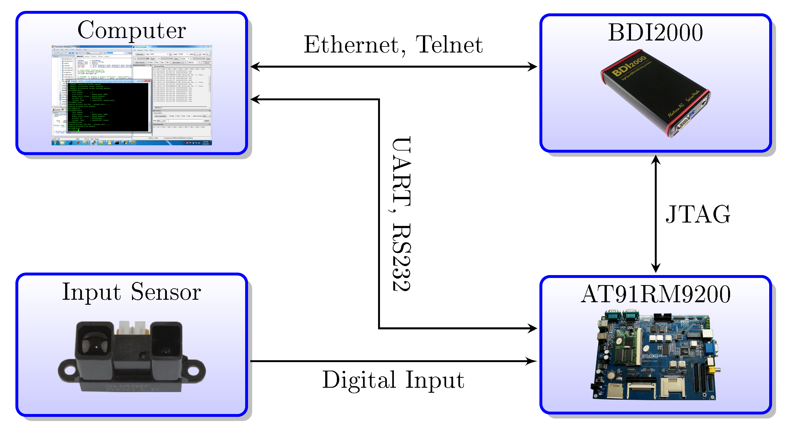
System Overview
[2,3,4]

Slide 5
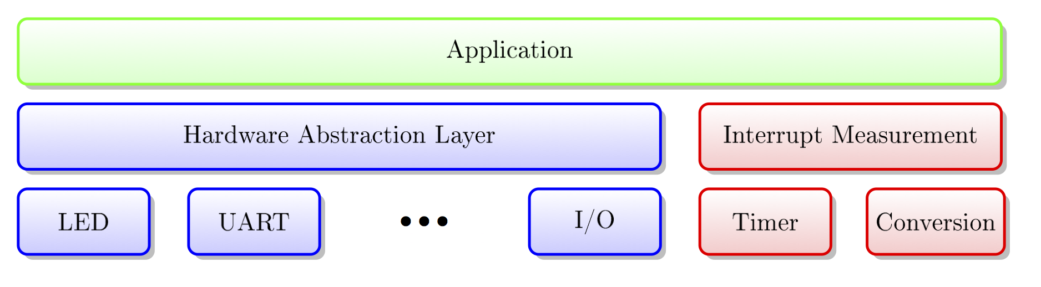
Hardware Abstraction Layer
Application independent of the hardware
Layering -> Information hiding
Limited by realtime constraints

Slide 6
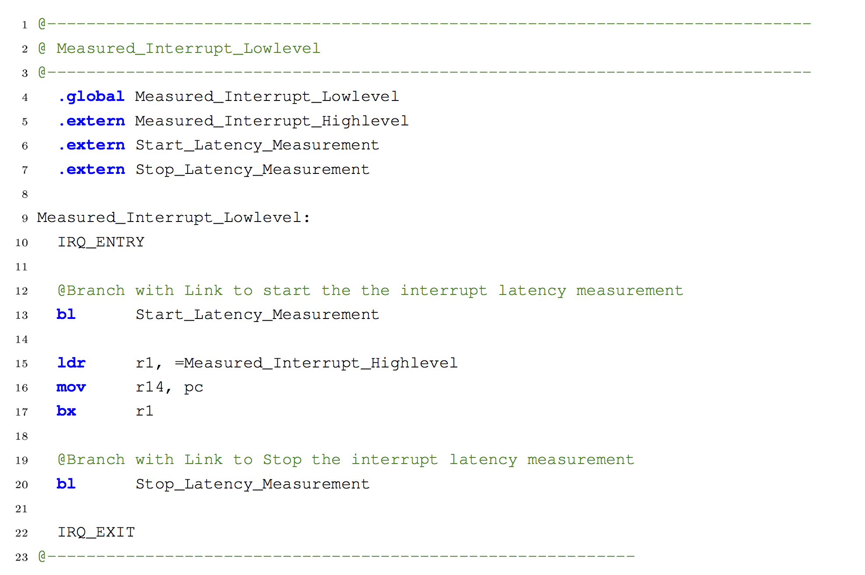
Interrupt handling

Slide 7
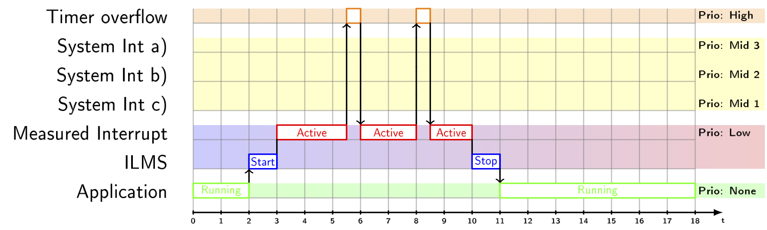
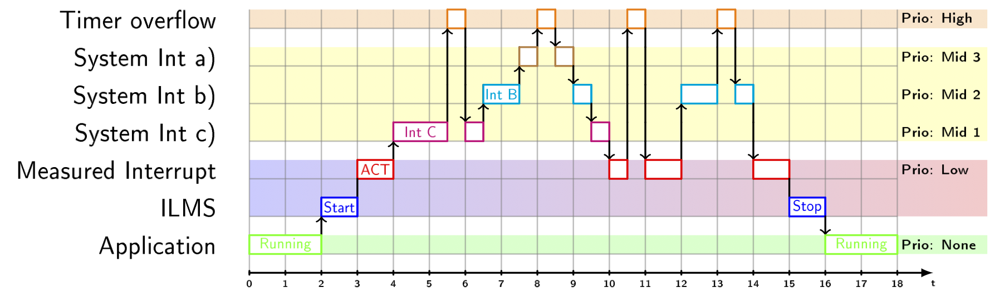
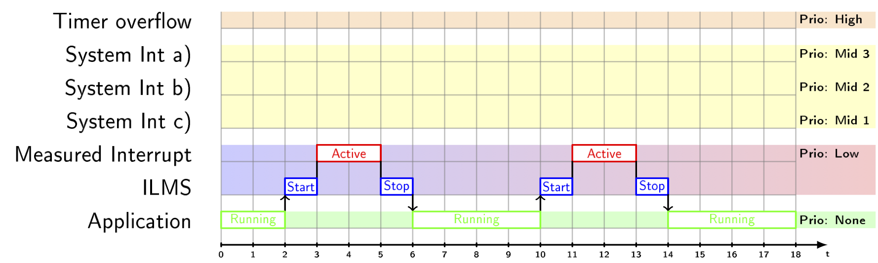
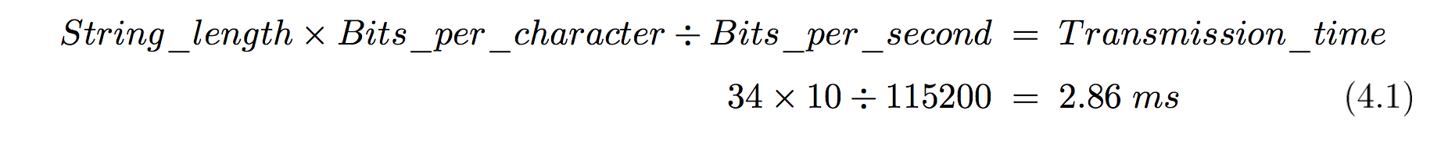
Latency measurement ILMS
Example
Transmission calculation

Slide 8
System limits and result correction
System limits:
Maximum around 25 Hz
One sporadic task measurable with next buffer
Result correction:
Estimate switching and serving time of the ISR
based on assembly instructions @1MIPS per MHz
Enabled and disabled depends use case

Slide 9
Read Data from ARM Processor
Java-Simple-Serial-Connector (JSSC) is used for reading the data from ARM9 Processor.
Steps Involved:
Open the port.
Set the parameters (Baud rate, Data bits, Stop bits, Parity).
Read bytes from serial port.
Close the port.
Data Format:
34 bytes of data in String format.
The data consists of timestamp, Latency value and the unit.
DD/MM/YYYY HH:MM:SS Value Unit\n
eg: "24/05/2014 16:59:39 0000080460 us\n“
Notes:
Data rate in bits per second is equal to the symbol rate in bauds.
The number of data bits in each character. 8 (for most kinds of data, as this size matches the size of a byte)
Parity is a method of detecting errors in transmission.
Stop bits sent at the end of every character allow the receiving signal hardware to detect the end of a character and to resynchronise with the character stream.

Slide 10
Database Prerequisites
Database Selection:
Oracle database 11g Express Edition is used.
SQL Developer is used for connecting to the database.
Table Creation:
The table consists of three fields (TIME, LATENCY, UNIT).
The following query is used to create the table.
create table sanjeev.latency
(
TIME TIMESTAMP,
LATENCY NUMBER,
UNIT VARCHAR2(25)
);

Slide 11
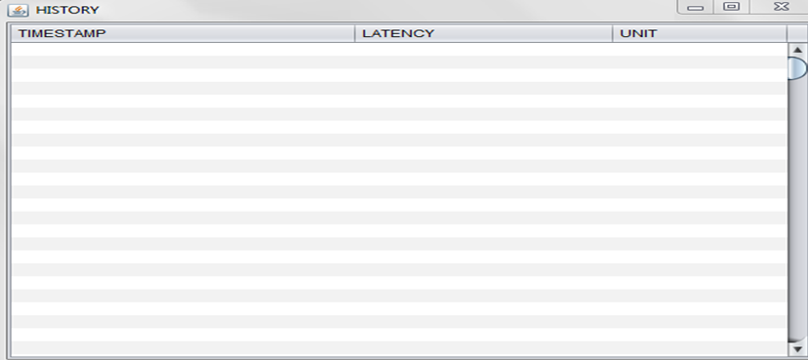
Adding values to Database
Field Separation:
The string is separated by “spaces” in-between.
String[] data = received_data.split(" ");
data[0] + data[1] = timestamp
data[2] = latency
data[3] = unit (us)
Writing to Database:
SQL Query.
"insert into sanjeev.latency values (TO_DATE('"
+ timestamp + "', 'dd/mm/yyyy hh24:mi:ss'),'"
+ Integer.parseInt(latency) + "','" + unit + "')";
us
24/05/2014 16:59:39 0000080460 us
0000080460
24/05/2014 16:59:39
0000080460
us

Slide 12
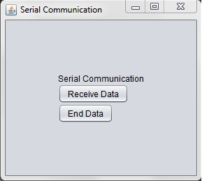
GUI for Receiving Data
Swing is the primary Java GUI widget toolkit.
Jbutton, Jlabel, JComboBox, JTextField, Jseparator are
used.
Notes:
Swing - part of Oracle's Java Foundation Classes (JFC) — an API for providing a graphical user interface (GUI) for Java programs

Slide 13
Threading
Threading concept is used.
Object instance is created.
Receive Data Button
start()
End Button
stop()
public void start() {
if (thread == null) {
thread = new Thread(this);
thread.start();
}
}
public void stop() {
thread.stop();
thread = null;
}
public void run() {
while (thread != null) {
ReadData();
}
thread = null;
}

Slide 14
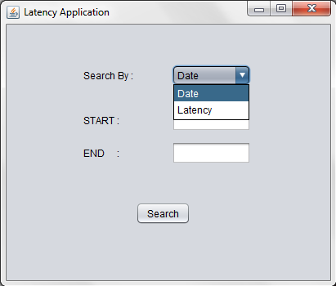
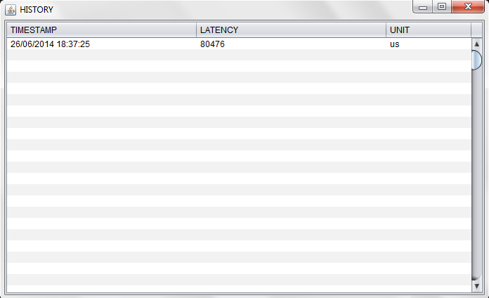
GUI For History of Latency
Search criteria:
By Date (Format : DD-MM-YYYY).
By Latency.

Slide 15
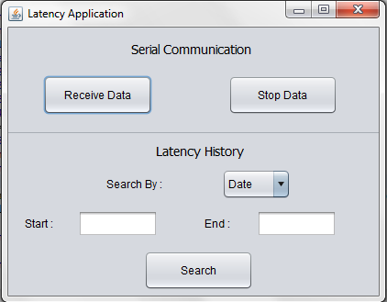
Integrated GUI
The Data Receiver GUI and the History GUI are integrated into one single GUI.

Slide 16
Conclusion ILMS
Results:
Measurement was implemented on chip
Precise result of around 1µs (depends on the timer)
Further work:
Message buffering, handshaking
Configuration via the Database/Application
Sync of the RTC
Result plausibility check

Slide 17
Conclusion Database Software
Results:
Data was successfully received and stored in the database.
A GUI is designed for storing and retrieving of the data to and from the data base.
Further work:
Flexible messages, timestamps and precision.
Search by time Criteria.
A web Application for retrieving of values.

Slide 18
DEMO
Thank You!!!

Slide 19
Sources
[1] http://de.farnell.com/atmel/at91rm9200-ek/kit-evaluation-fuer- at91rm9200/dp/1629536
[2] http://www.alldatasheet.com/datasheet-pdf/pdf/412638/SHARP/ GP2Y0D02YK0F.html
[3] http://image.ec21.com/image/arm97/oimg_GC01721389_CA01721724/ AT91RM9200_Development_Board.jpg
[4] http://wiki.ntb.ch/infoportal/_media/embedded_systems/abatron_bdi/ bdi2000.jpg

